Slide 1


Data Analysis and Visualization

Slide 2


Today's agenda
Project recap
Problem
The Analytics team
Process
Insights
Summary

Slide 3

sdfdf
Social buzz, a fast growing social media platform, needs to adapt to its growth on a global scale. To tackle this issue Accenture has started a 3 month POC focusing on these 3 tasks
-An audit of their big data practice -
Recommendations for a successful IPO -
An analysis of their content categories that highlights the top 5 categories with the largest aggregate popularity
Project Recap

Slide 4


Problem
Over 100000 posts per day
36,500,000 pieces of content per year!
But how to Capitalize on it when there is so much?
Analysis to find Social Buzz’s top 5 most popular categories of content

Slide 5



Edrees Zalmai
Data Analyst
The Analytics team
MARCUS ROMPTON
Senior Principal
ANDREW FLEMING
Chief Technology Architect

Slide 6
Process
1
Data Understanding
2
Data Cleaning
3
Data Modeling
4
Data Analysis
5
Breakdown insights

Slide 7

Insights
16 Unique Categories
1765 Posts under “Animals” category
The Animal category had the highest positive engagement out of users

Slide 8
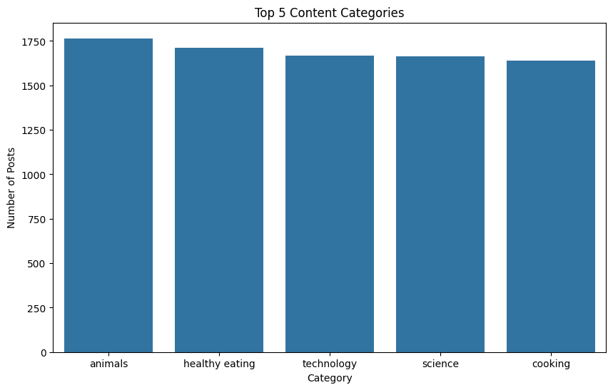

Slide 9
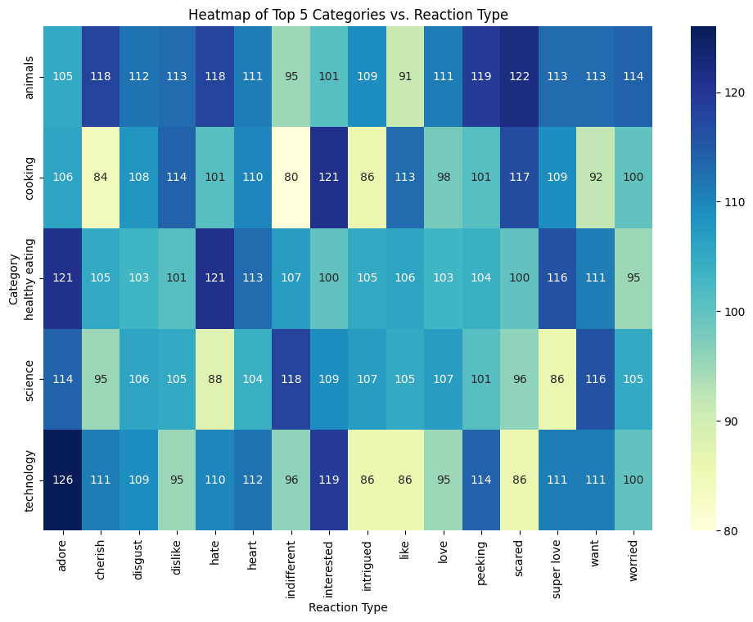

Slide 10
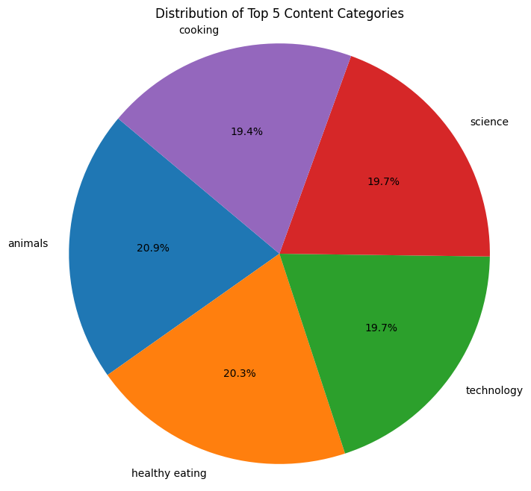

Slide 11

Insight: While going through a detailed analysis of user reactions across various content categories, it was found that the top five categories in terms of aggregate popularity are animals, healthy eating, technology,science, and cooking. These categories had a consistent engagement of positive reactions. The animals category led the group with the highest amount of posts and reactions!
Analysis: The heatmap that I generated showcased the patterns in user engagement in each category. For example, the animals category and healthy eating scored high in emotionally positive reactions whereas technology and science had more users curious and intrigued. The pie chart that I generated also showcases a balanced distribution among the top 5 categories
Summary
Moving Forward: To gain more engagement, content that is generated on the platform should focus on more animal and healthy eating categories as this brought strong emotional responses as well as user engagement. Also looking into implementing emotional hooks to techonology and science based content may also see a surge in user engagement

Slide 12

Thank you!
ANY QUESTIONS?

